Slide 1

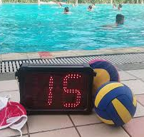
Shot Clock Timer
Table Education
Understanding the Role and Responsibilities
San Diego Water Polo Officials' Association
SDWPOA Home - www.sdwpoa.org
Official Training Module

Slide 2
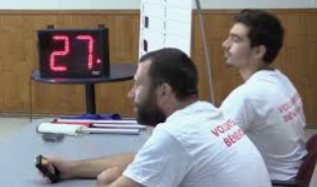
Shot Clock Timer
The purpose of the Shot Clock Timer is to time periods of continuous ball possession by the offensive team
This this duty often incorporated into the Clock Timers duty

Slide 3
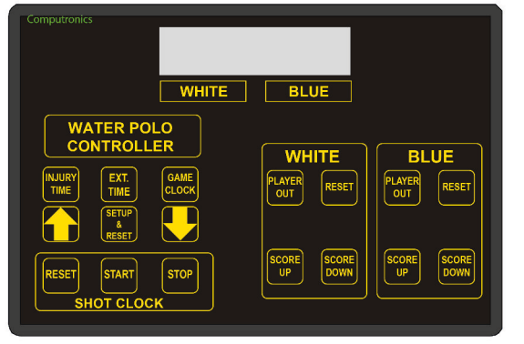
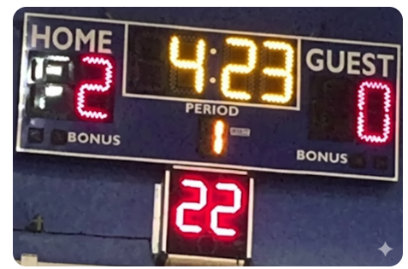
Shot Clock Operation
Shot Clock Starts:
When team gains clear possession on sprint
When player puts ball in play

Slide 4
Shot Clock Operation
Shot Clock Stops:
On any whistle
Starts again when player puts ball into play
Whistle
→
Clock Stops
→
Ball in Play
→
Clock Starts

Slide 5
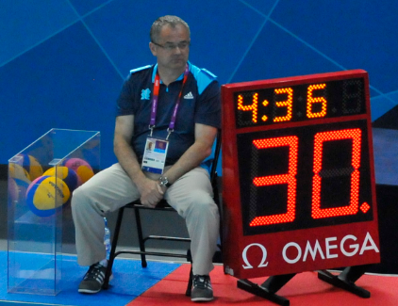
Shot Clock Operation
Shot Clock Resets:
Shot on Goal
  Reset when ball leaves shooter's hand
Change of Possession
  Goal
  Contra-Foul (Offensive foul)
  Ball Under
Defensive Fouls
  Exclusion or penalty shot by defending team
Goalie Tip
  Ball tipped over goal line by goalie
Corner Throws
  2-meter throws (normally from goalie tip)
Neutral Situations
  Neutral Throw ("Jump Ball")
  End of Period

Slide 6
Shot Clock Scenario
Crossbar Rebounds
Scenario: Shot hits crossbar and rebounds into field of play
Action: Reset shot clock when either team gains clear possession
Double Exclusion
Scenario: One exclusion on each team simultaneously
Action: Shot clock and game clock do NOT reset - offensive team keeps possession with remaining time
Scramble
Scenario: Goalie blocks shot, ball bounces back to offensive team
Action: The shot clock should be reset on shot and again when offense regains possession of the ball.
Block During Shot Attempt
Scenario: Defender blocks the ball just as offensive player is shooting
Action: If ball never left hand = do not reset clock. If ball left hand = shot attempt, clock reset on shot

