Slide 1

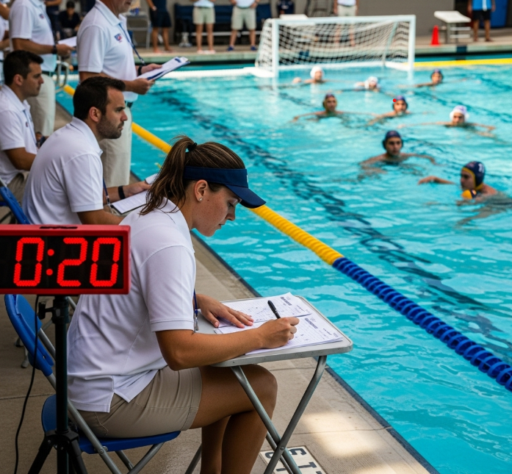
Exclusion Secretary
Table Education
Understanding the Role and Responsibilities
San Diego Water Polo Officials' Association
SDWPOA Home - www.sdwpoa.org
Official Training Module

Slide 2
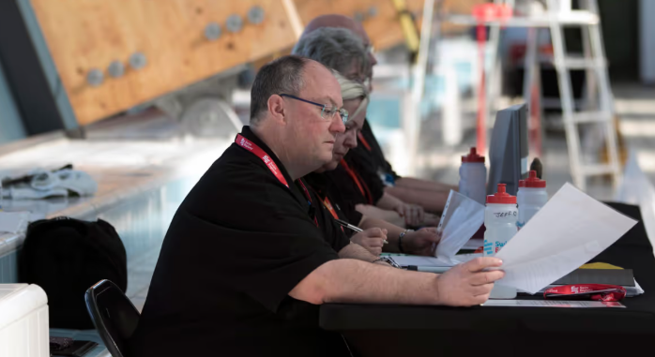
Purpose of the Exclusion Secretary
📊 Track Fouls
Maintain accurate count of personal fouls
⏱️ Time Exclusions
Track the 20-second exclusion period accurately
🚩 Signal Re-entry
Alert the player when they may legally re-enter the game
⚠️ Monitor Violations
Alert referees if a player enters early or illegally
🔄 Backup Protocol
If Exclusion Secretary is unavailable, Clock operator takes over duties as backup

Slide 3
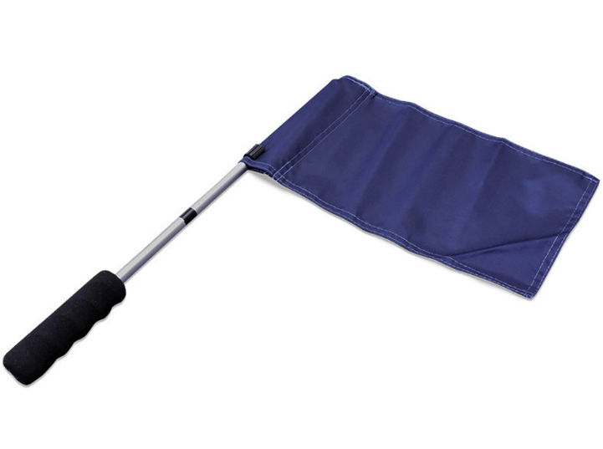
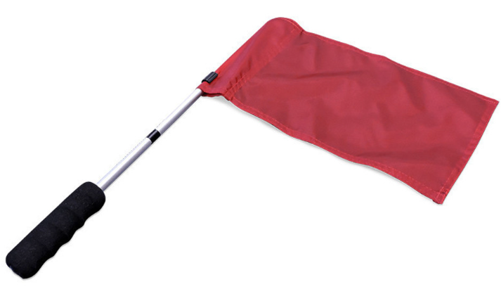
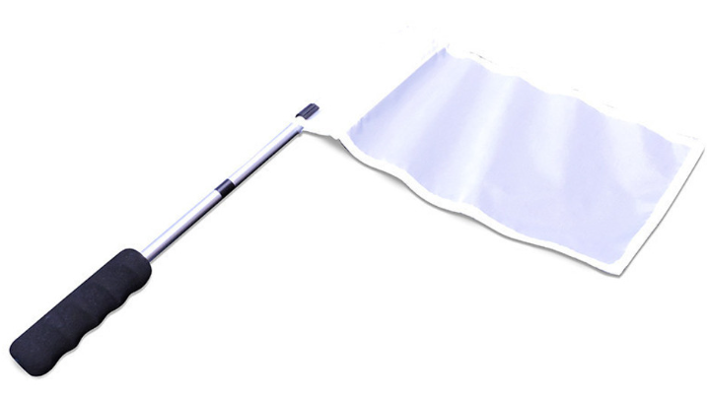
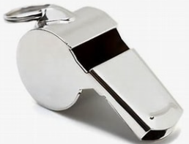

Required Equipment
White Flag
For signaling white cap team players back into the game
Blue/Dark Flag
For signaling dark cap team players back into the game
Red Flag
For indicating a player's third personal foul
Additional Equipment
Whistle or loud horn
Clipboard with Exclusion Sheet(An Exclusion Sheet and other table education can be found at https://www.sdwpoa.org/table-instructions.html )

Slide 4
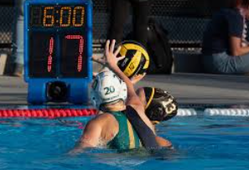
Exclusion Timing
Exclusion Duration
⏰ 20 seconds of actual game time
⚽ Ends early if a goal is scored
🔄 Ends early if possession changes
Re-entry Time
🕐 Subtract 20 seconds from the game clock at the time of exclusion
Example:
🕐 Exclusion at 3:45 game clock
✅ Re-entry time: 3:25
🧮 (3:45 - 0:20 = 3:25)

Slide 5
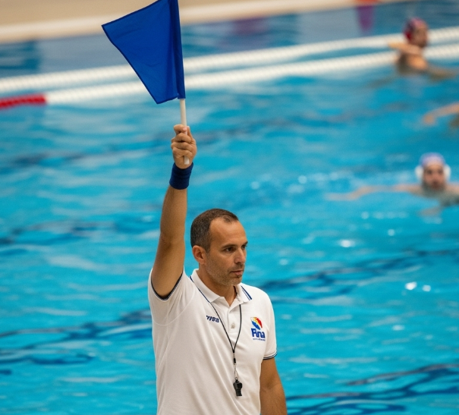
Flagging Players In
How to Signal
🏳️
White Team Player
Use WHITE flag
🏴
Dark Team Player
Use DARK flag
→
🎯 Proper Technique
Hold flag so excluded player can see the whole flag
👁️ Visibility
Ensure both player and referees can see the signal
⏰ Timing
Flag exactly when 20 seconds expires or early conditions met
⏱️ Hold Duration
Keep flag raised until player enters water

Slide 6
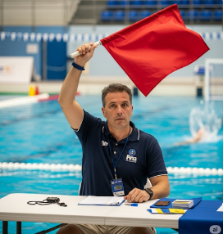
Personal Fouls
Three Personal Fouls Rule
🚩 Raise RED flag toward the bench
🗣️ Alert referees immediately
❌ Do NOT wave player in
⏳ Wait for substitute to enter
Penalty Shots
📊 Count as personal fouls
✅ Player stays in game unless 3rd foul
📝 Track carefully on scoresheet
Player with 3 personal fouls must be substituted and cannot return to the game

Slide 7
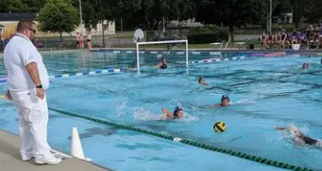

Special Situations
End of Period
🔄 Remaining exclusion time carries over to next period
🏃‍♂️ If team wins sprint, player may enter early
🗣️ Communicate carryover time clearly
Substitutions During Exclusion
⏳ Substitute must stay in exclusion area
🏊‍♂️ Can only enter after original player touches wall or surfaces
⏱️ Same exclusion time applies to substitute

Slide 8
Early or Illegal Entry
🚨 If a Player Enters Early or After 3rd Foul - Take Immediate Action
🗣️ Primary Alert
Verbal alert: "Illegal entry!" or "Early entry!"
Secondary Alert
Use whistle or horn to get referee's attention
👉 Follow-up
Point to the player who entered illegally
📝 Documentation
Note the incident on your scoresheet
⚡ Speed and clarity are essential for proper game management

